Slide 1
state of our profession: The Challenges and triumphs of special education
Pioneer Division/Council for Exceptional Children
4.10.19
William K. Bogdan, Mary Ruth Coleman,
& Susan Fowler
Notes:
Susan

Slide 2
Presentation Agenda
Over view of the ”State of the Special Education Profession” Survey Design and Respondents
Voice of the Teachers: Survey Findings
Role of the IEP in Specialized Instruction
Competence Using Recommended Practices
Engagement with Families
Systems Level Supports
What Teachers Need to be Successful
What does it Mean for Special Education?

Slide 3
State of the Special Education Profession Survey Proposal
2016: CEC-Pioneer Division proposed to the CEC Board an update of the Bright Futures (2000) report.
Bright Futures report, nearly 20 years ago, focused on the State of the Profession then and identified multiple concerns.
The CEC-PD executive board recommended that an update was overdue, that the profession had grown through the development of more recommended practices and revised standards.
Notes:
Bill

Slide 4
State of the Special Education Profession Study (2016-2019)
Study Purpose
To provide a current snapshot of the state of the profession which will serve as a data-base foundation for CEC’s leadership activities. This foundation will: establish a baseline and allow us to build trend lines to monitor change; allow us to make data-based decisions on policy, program, and professional development initiatives; and provide support for initiatives aimed at improving outcomes for individuals with disabilities, including those who are twice exceptional, their families, and the professionals who serve them.
CEC Board of Directors Motion (November 2016)
To establish a State of the Profession Workgroup and project conducted jointly by CEC and the CEC Pioneers Division.
The Workgroup Charge
Establish a workflow plan of action and timeline
Develop the study methodology
Coordinate grant proposal, study, results, implications, and outcomes with the CEC-PD executive committee, the CEC Board of Directors, and the CEC divisions through the CEC IDC.

Slide 5
State of Profession Design Team
Mary Ruth Coleman (Chairperson, CEC Past President)
Bill Bogdan (Chairperson, CEC Past President)
Susan Fowler (Chairperson, CEC-Past President)
Joan McDonald (CEC-Pioneer Division)
Gloria Taradash (CEC-Pioneer Division)
Kelly Carrero (DDEL, Interdivisional Caucus)
Paul Zinni (CEC-Pioneer Division, CEC Board of Directors)
Mikki Garcia (CEC Past President)
Mary Lynn Boscardin (CEC President)
Alex Graham (CEC Executive Director)
Judy Harrison (CEC Director, Membership, Marketing, Communications)
Notes:
Susan

Slide 6
Development of the State of the Special Education Profession Survey
Information gathering strategies in the survey development
Four focus groups were conducted at two CEC conventions and two summer leadership meetings.
Survey was developed from focus group findings and pilot testing at CEC leadership events and with the State of the Special Education design team (with iterative revisions).
Final testing with a Survey Gizmo format for on-line completion by Design Team members.
Notes:
Bill

Slide 7
Fall 2018 Survey Administration
Participants: CEC identified 9,103 current and recently lapsed members who self-identified as special education teachers. They received the survey in the first wave.
CEC advertised the survey through Special Education Today, through Divisions, at conferences, and invited additional teachers to apply to participate.
1,570 responded and non duplicated requests received access to survey in a second and third wave.
Usable responses: 1,467 / potential 10,251= 14.3%
Notes:
Bill

Slide 8
Respondent Characteristics
Who responded?
Licensed or certified in special education: 96%
Completion of Master’s degree: 69%
Taught in public schools: 91%
Female 89%
White 72%
Resided in the United States 99%
Responding from 50 States and 4 Provinces
Notes:
Bill

Slide 9
Percentage of Years of Special Education Teaching Experience (Figure 1)
10+ Years Experience = 68%
1-3 Years Experience = 7%
Notes:
Bill

Slide 10
Percental of Teachers Serving in Continuum of Settings (Figure 2)
Figure 2: Setting in which Teachers Reported Spending 50% or More Time In
Notes:
Bill

Slide 11
Percentage of Teachers Reporting Age Groups Served (Figure 3)
Notes:
Bill

Slide 12
Findings Section I: Role of the IEP
Notes:
Susan

Slide 13
IEP Use To Modify Curriculum (Figure 4)
Nearly all teachers use the IEP frequently and modify curriculum often (Figure 4)
Notes:
Susan

Slide 14
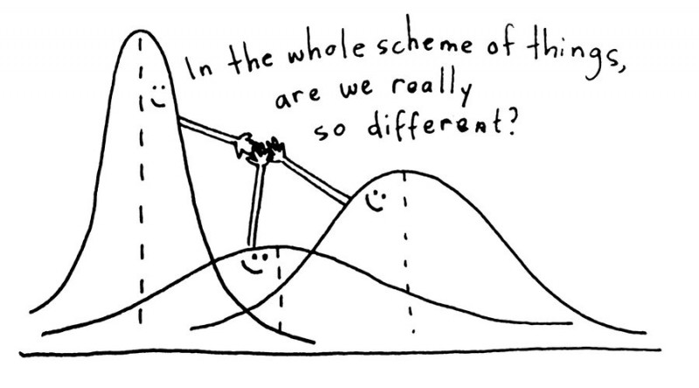
IEP Use in different Settings
ANOVA indicates that teachers in self-contained classrooms refer to the IEP and modify curriculum more frequently than other special education teachers.
Notes:
Susan

Slide 15
Ratings of Preparation to Teach Students with Exceptionalities (Figure 5)
Teachers rate themselves and related service providers as more prepared than other colleagues (Figure 5)
Notes:
Susan

Slide 16
Percentage of Time Available for Planning (Figure 6)

Slide 17
Key Take Aways IEP
The IEP is a living breathing document used to guide and plan instruction.
Teachers report general education colleagues are less well prepared to support IEP goals
Teachers need more time to work with the IEP teams for planning and implementing.
Notes:
Susan

Slide 18
Findings Section II: Competence Using Recommended Practices
Notes:
MR

Slide 19
Percentage Rating of High Competence in Use of Assessments (Figure 7)
Notes:
MR

Slide 20
Percentage Rating High Competence in Instruction (Figure 8)
Notes:
MR

Slide 21
Percentage rating high confidence in classroom organizational practices (Figure 9)
Notes:
MR

Slide 22
Percentage Rating Confidence in Use of Discipline (Figure 10)
Notes:
MR

Slide 23
Key Take-Aways Teachers Competence in Recommended Practices
Teachers rate themselves as very to extremely competent in the use of most practices.
More than half, however, identified areas of need with culturally relevant practices.
The use of strength-based approaches and High Leverage Practices
was a additional area of
need.
Notes:
MR

Slide 24
Findings Section III: Engagement with Families

Slide 25
Teacher Engagement with Families (Figure 11)
Notes:
Susan

Slide 26
Percentage of Teachers Rating of Students’ Sense of Belonging (Figure 12)
Notes:
Susan

Slide 27
Key Take Aways on Family Engagement
Teachers were less confident around family engagement than any other topic on the survey.
In particular working with families who differ from them demographically.
Teachers report needing more support
to work with families.
Student’s belonging is
related to setting served.

Slide 28
Findings Section III: Systems Level Supports
This Photo by Unknown Author is licensed under CC BY-SA-NC

Slide 29
Administrative support for collaboration (Figure 13)
Notes:
Bill

Slide 30
Percentage of Teachers Reporting Supports to Enhance Teaching as Available Most of the Time (Figure 14)

Slide 31
Ratings of Supervisors and Administrators’ Preparation to Support IEP (Figure 15)

Slide 32
Percentage of Teachers Identifying Evaluation Topics and Their Importance (Figure 16)

Slide 33
Key Take-Aways on Support for Teachers
Nearly Half of respondents report collaborative practices within their schools and districts.
Fewer teachers rate their non-special education district and building administrators as very prepared to support instruction for IEP outcomes.
A range of professional development opportunities are available for most teachers.
Evaluation topics were viewed as
important, however, IEP goals and
outcomes were not evaluated.
Notes:
Bill

Slide 34
Findings Section V: What Teachers Need Most
This Photo by Unknown Author is licensed under CC BY-SA

Slide 35
What Teachers Need to be Successful
Teacher Responses:
Adequate resources to to meet IEP requirements for my students (831 responses)
Smaller class sizes/caseloads (637 responses)
Administrators who support the IEP process (538 responses)
Notes:
MR

Slide 36
What Teachers Need Most
4. Knowledgeable para-educators
5. Principal who is a strong instructional leader
6. Professional Development
7. Reduced Paperwork
8. Access to Related Service Providers
9. Access to technology
10 Access to General Education Curriculum
Notes:
MR

Slide 37
Key Take-Aways for Teacher Success
Teachers affirm the importance of the IEP and the resources to reach the IEP goals.
Class size and Caseloads were reported as critical to success.
The knowledge and support of
Administrators was also seen
as critical to success.

Slide 38
Next Steps
How do we use this information to improve:
Professional Development & Standards
Policy & Advocacy
Programming & Practice

